Slide 1
Spatial Analysis of Health Care Spending in Maryland
By: Devin Webb

Slide 2
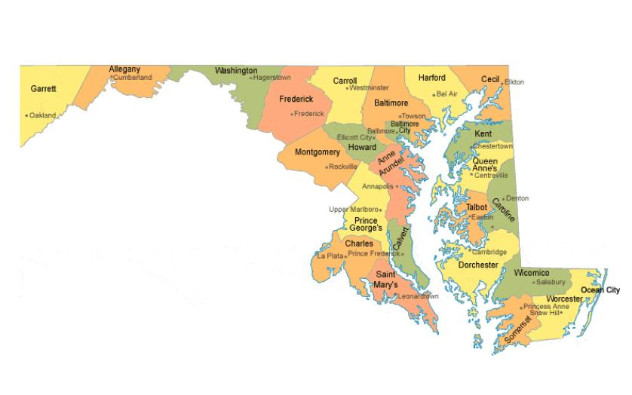
Understanding health care spending is critical for policy-making and resource allocation, especially at the local level.
This analysis focuses on the spatial patterns of health care spending across the census tracts of Maryland in 2022, utilizing consumer spending data from ESRI.
Exploring these patterns helps identify areas of high and low expenditure, potential disparities in health care access, and can guide health services planning.
The data used in this study comes from the ESRI U.S. Consumer Spending database and is licensed for academic use by the University of Maryland.
The key attribute field under study is '2022 Medical Care' (X8018_X), representing the total spending on medical care per census tract.

Slide 3
Questions
What are the overarching patterns of health care spending at the census-tract level in Maryland?
Where are the areas of very low healthcare spending diversity located within Maryland, and what might this indicate about healthcare access in those regions?
Is there evidence of significant spatial autocorrelation in health care spending across Maryland, suggesting clustered or dispersed patterns?
Where are the specific clusters or outliers of high and low health care spending located within Maryland?

Slide 4
Data Set Overview
The analysis utilizes ESRI's U.S. Consumer Spending database for the year 2022, focusing on census-tract-level data for the state of Maryland.
The primary attribute for analysis is '2022 Medical Care Spending' (variable X8018_X), which encompasses total expenditures on medical care within each census tract.
Data preprocessing involved the selection and extraction of the '2022 Medical Care Spending' attribute and standardizing the data for comparability across census tracts.
Additional preprocessing steps included validating the consistency of the data, ensuring no missing values, and normalizing spending figures based on tract population where necessary.
The dataset covers a wide range of consumer spending behaviors but for this study, the scope is narrowed to health care spending to address specific research questions.
Limitations include potential underreporting in certain demographics and the exclusion of institutional spending on health care.

Slide 5
Approach to Spatial Analysis
To assess the diversity of healthcare spending, we'll compute the Shannon's Diversity Index for each census tract. This index measures the entropy of spending distribution, providing a metric of variability and richness in healthcare expenditures.
Moran's I will be used to detect overall spatial patterns, whether health care spending is generally clustered, randomly distributed, or dispersed across Maryland. This measure helps in understanding broad regional differences
Local Moran’s I will identify specific hot spots and cold spots within Maryland, pinpointing local clusters of high and low spending relative to the state average. This detailed local perspective complements the global analysis provided by Moran’s I.

Slide 6
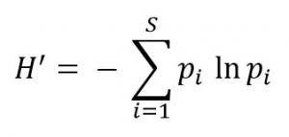
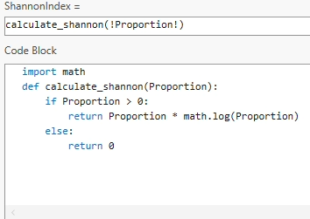
Shannon’s Diversity Index Calculation
The Shannon Diversity Index (SDI) quantifies the diversity of healthcare spending within Maryland's census tracts.
SDI is calculated using the proportion of each tract’s spending relative to the state’s total spending.
A higher SDI indicates a greater diversity of spending, suggesting a wider variation in healthcare consumption patterns.

Slide 7
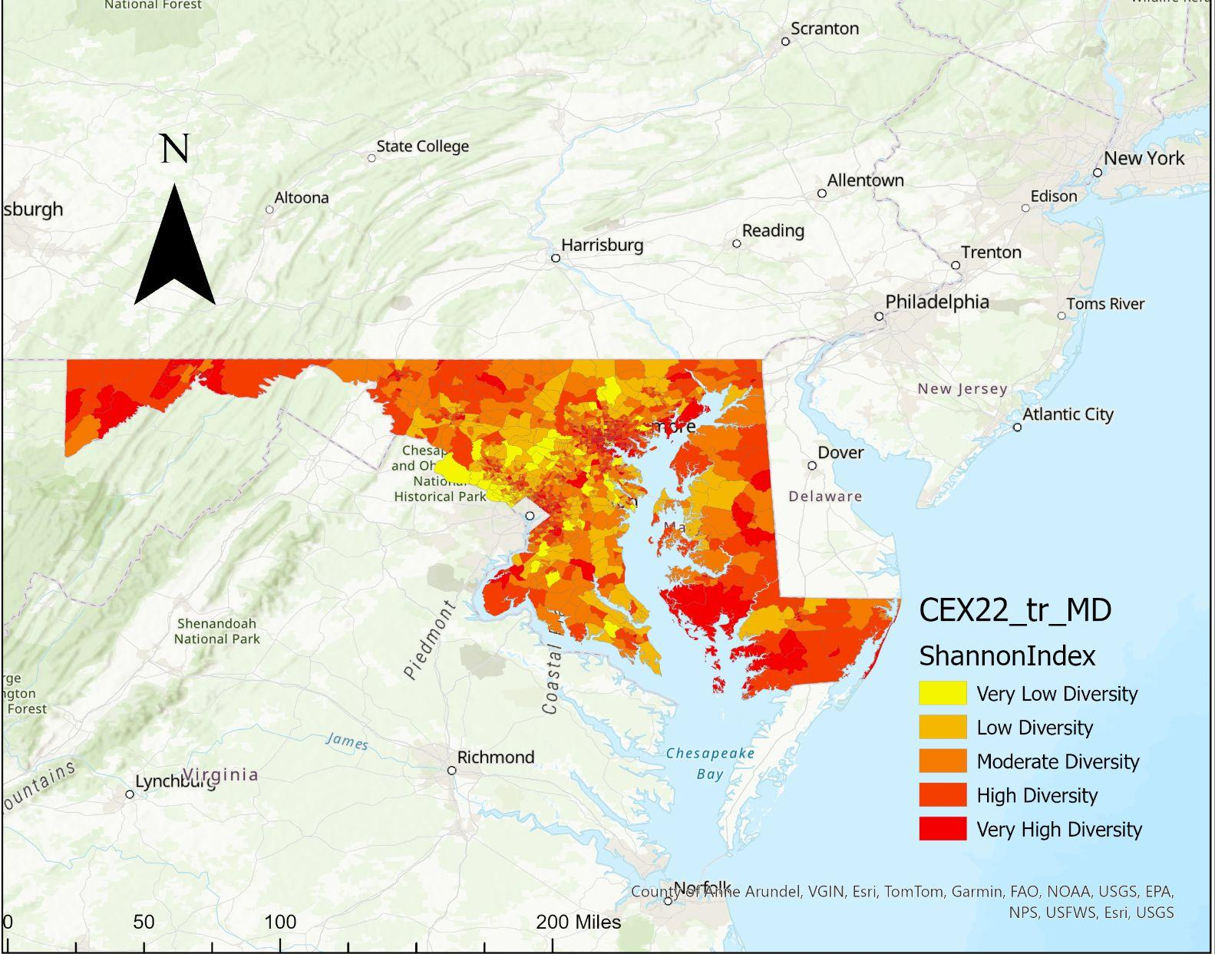
Spatial Distribution of Shannon’s Diversity Index
This map visualizes the SDI values across Maryland, offering a spatial perspective of healthcare spending diversity.

Slide 8

Conclusions from SDI
Observations
Implications
Conclusion
The map illustrates areas with varying levels of healthcare spending diversity, highlighting disparities across Maryland.
"Regions marked with 'Very High Diversity' demonstrate a richer mixture of healthcare spending, potentially indicating a wider range of services and access points for healthcare.
Conversely, areas of 'Very Low Diversity' may suggest a lack of variety in healthcare service expenditures, which could point to gaps in service provision or accessibility.
The findings suggest targeted areas for healthcare investment, particularly in regions showing lower diversity, to ensure a more equitable distribution of healthcare resources.
Low-diversity areas might be underserved, indicating a potential need for public health interventions or private healthcare investment.
The SDI analysis points towards a pronounced variability in healthcare spending across Maryland, with potential implications for healthcare accessibility and quality.
There is an opportunity to leverage these findings to inform healthcare policy, investment decisions, and strategic planning, aiming to balance healthcare service availability across the state.
Addressing the areas identified as having 'Very Low Diversity' should be prioritized to ensure equitable healthcare service distribution and to improve overall health outcomes in underserved regions.
Continued monitoring and reevaluation of SDI over time will be critical to assess the impact of interventions and changing healthcare landscapes.

Slide 9
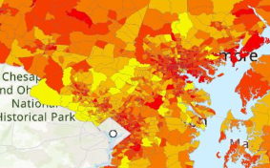
Question Discussion
Question: Where are the areas of very low healthcare spending diversity located within Maryland, and what might this indicate about healthcare access in those regions?
Areas marked as 'Very Low Diversity' in healthcare spending may indicate a lack of healthcare service providers, less variety in available healthcare services, or lower healthcare spending by residents.
A lot of very low diversity seems to happen to the West and north west of College Park.
Zoomed In image of map

Slide 10
Global Spatial Autocorrelation in Healthcare Spending
This analysis uses Moran's I, a measure of global spatial autocorrelation, to assess the distribution of healthcare spending across Maryland. It identifies if spending is systematically arranged in a clustered, dispersed, or random pattern over the area.
The outcome of this analysis can guide policymakers. A positive Moran's I would indicate clustering of high or low healthcare spending, suggesting areas of potential over or underinvestment in healthcare infrastructure. A negative value would suggest a dispersed pattern, potentially indicating equitable healthcare spending.
Insights from Moran's I in Maryland: Preliminary results may reveal spatial inequalities in healthcare spending, which can impact the planning and distribution of healthcare resources. Identifying these patterns is crucial for targeted interventions and ensuring healthcare equity across the state.

Slide 11
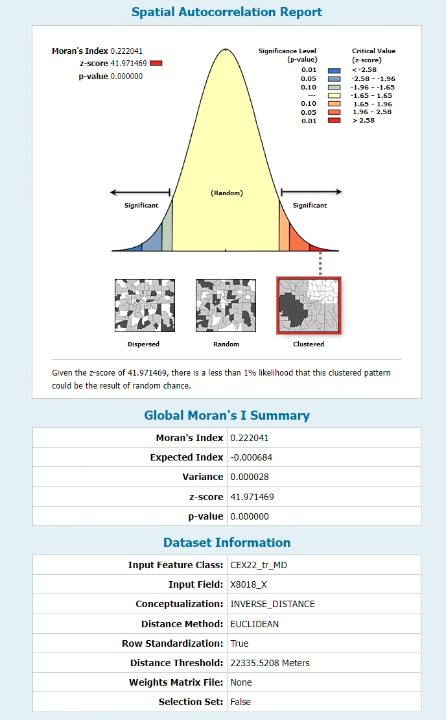
Global Spatial Autocorrelation
Overview of Findings:
The positive Moran's I index of 0.222 indicates a clustered pattern of healthcare spending diversity in Maryland.
This suggests that census tracts with similar spending habits are geographically close to each other.
Significance of Results:
The Z-score of 41.971469 is significantly high, indicating that the observed spatial pattern is very unlikely to be random (p-value < 0.00000).
It points towards the existence of regional disparities in healthcare spending diversity that are non-random and potentially influenced by underlying social or economic factors.
Implications for Policy and Planning:
Identifying clusters of high and low diversity can inform targeted interventions and resource allocation.
Policy-makers might focus on these clustered areas for in-depth studies to understand the driving forces behind the patterns.

Slide 12
Question Discussion
Question: Is there evidence of significant spatial autocorrelation in health care spending across Maryland, suggesting clustered or dispersed patterns?
Evidence of Spatial Autocorrelation: The positive Moran's I value of 0.222 indicates a clustering pattern rather than a random or dispersed distribution. This suggests that tracts with similar levels of healthcare spending are more likely to be located near each other.
Statistical Significance: The Z-score of 41.971469 far exceeds the threshold for statistical significance, suggesting that the clustered pattern is very unlikely due to random chance, with a p-value close to 0.
Interpretation: The evidence of significant spatial autocorrelation in healthcare spending suggests that there are systematic factors at play influencing the distribution of healthcare spending across Maryland. This could be due to a combination of factors such as socioeconomic status, access to healthcare facilities, or policy-driven resource allocation.

Slide 13
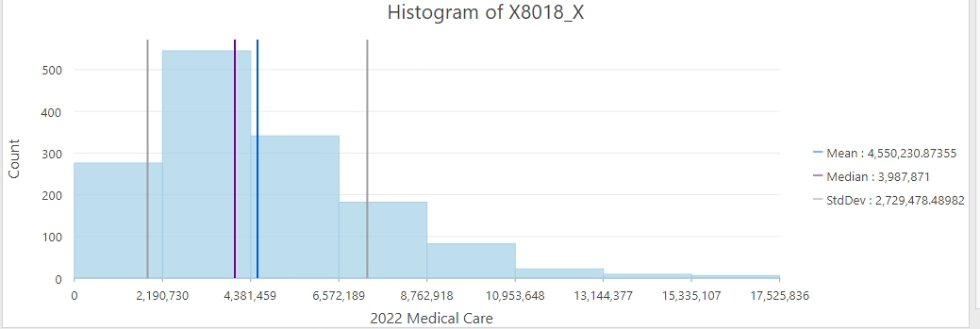
Local Spatial Autocorrelation in Healthcare Spending
The histogram shows the distribution of healthcare spending across Maryland's census tracts. The majority of tracts fall within the lower spending categories, indicating a skew towards lower healthcare spending in the state.
Local Moran's I is utilized to detect spatial clusters and outliers of healthcare spending in Maryland at a granular level, pinpointing specific areas of high or low spending relative to their neighbors.
The analysis has identified significant clusters where high values are surrounded by high values (High-High) and low values by low values (Low-Low), as well as outliers where high values are surrounded by low values (High-Low) and vice versa (Low-High).
Clusters of high healthcare spending diversity may suggest regions with robust healthcare service offerings, whereas low-low clusters could indicate areas lacking in service diversity, potentially impacting healthcare accessibility.
X8018_X = Medical Care Spending
The mean healthcare spending across the tracts is $4,550,230, suggesting that while there may be tracts with very high spending, overall spending tends to be lower. The median, at $3,987,871, indicates that more than half of the tracts spend below the average, reaffirming the skew towards lower spending

Slide 14
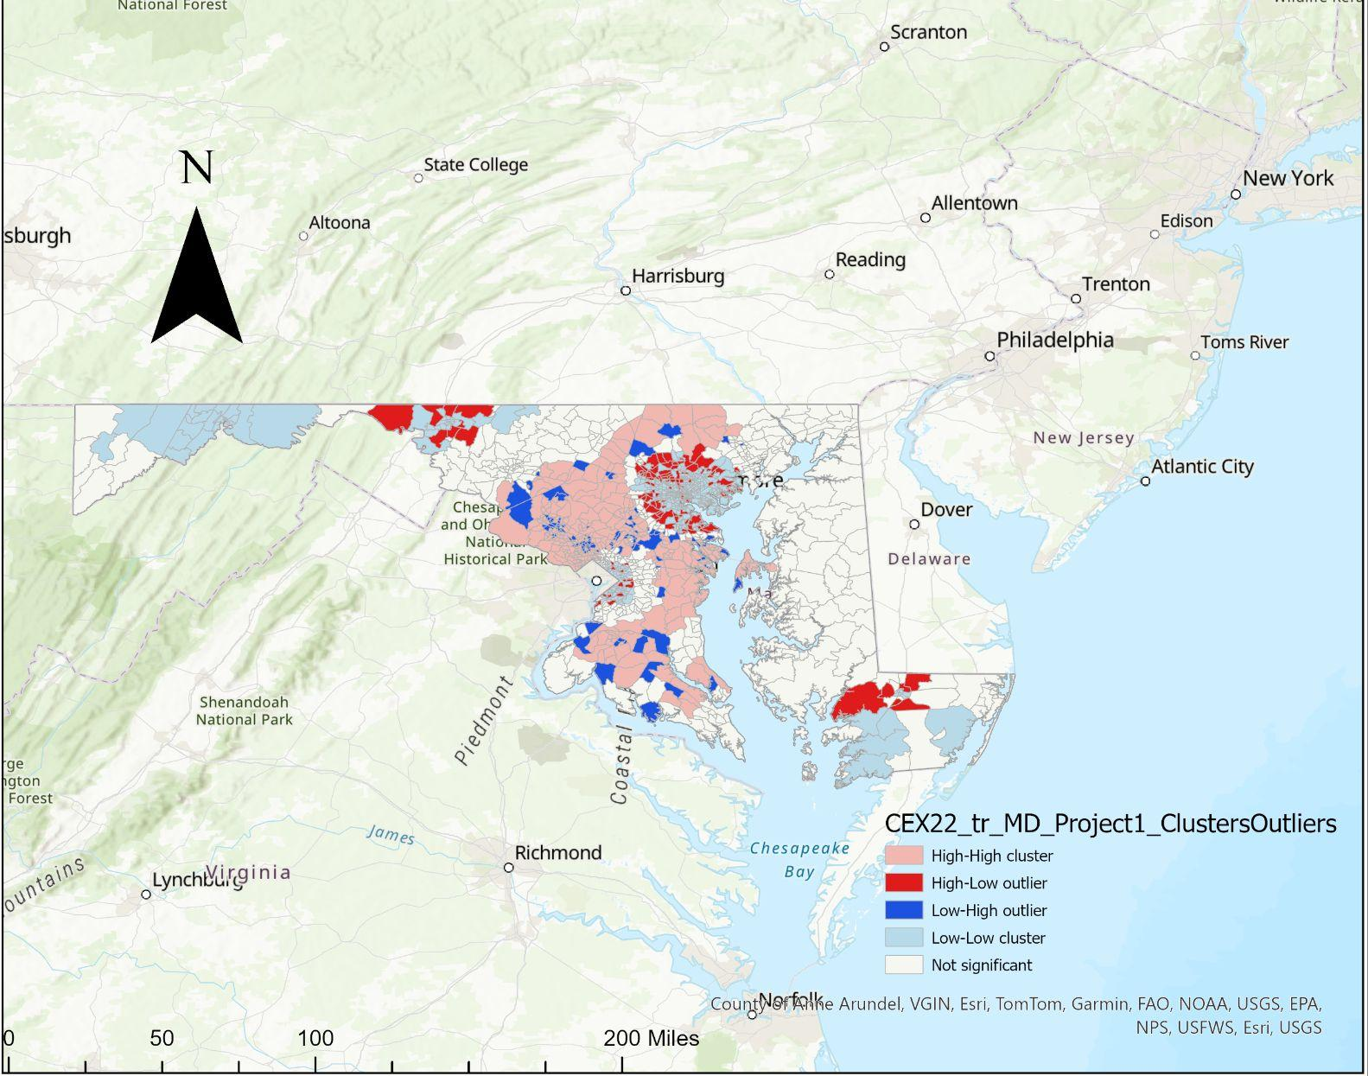
Clusters and outliers
This map presents the results from the Local Moran's I analysis, revealing the spatial patterns of health care spending diversity within Maryland at the census tract level.
Pink areas represent 'High-High' clusters, indicating tracts with high healthcare spending surrounded by tracts with similarly high spending. These could be areas with more affluent populations or higher concentrations of healthcare facilities.
Light blue areas indicate 'Low-Low' clusters, where tracts with low healthcare spending are surrounded by tracts with similarly low spending. This might suggest regions with potential underservice or lower economic activity."
Darker Blue and red areas show outlier tracts, where the spending is significantly different from their neighbors. These could point to unique local conditions or anomalies in service provision.

Slide 15
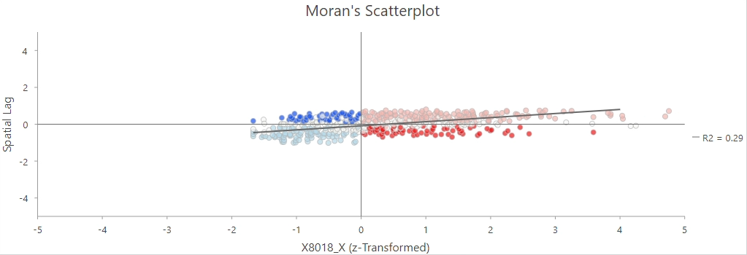
Question Discussion
Question Where are the specific clusters or outliers of high and low health care spending located within Maryland?
X8018_X = Medical Care Spending
High-High clusters happened to be to the North, East, and South of DC. They are also to the West and North of Baltimore.
The Low-Low Clusters were very close to DC and some regions inside of the baltimore area. There are also areas of Low-Low Clusters in western Maryland and on the southern peninsula of Maryland. These areas are popping up in rural areas most likely due to the overall lower spending on medical care.
Outliers of both of these areas are seen right next to each other in these densely packed cities. This indicates that in some tracts people are areas of low spending, which could be due to various socio-economic factors.

Slide 16
Conclusion
Question: What are the overarching patterns of health care spending at the census-tract level in Maryland?
Analysis reveals distinct regional variations in healthcare spending. Urban centers show higher spending diversity, reflecting a broader range of services, while rural tracts exhibit lower diversity, indicating potential service deserts.
The Shannon Diversity Index (SDI) reflects the variety of healthcare spending across census tracts. Urban areas generally displayed higher SDI scores, suggesting a wider range of healthcare spending behaviors and service availability.
The Global Moran’s I analysis demonstrated a clustered pattern of spending, suggesting that similar spending levels are geographically proximate. This pattern is indicative of socio-economic and policy-driven healthcare service allocation.
Local Moran's I results identified specific areas where spending is significantly higher or lower than the state average, which may correlate with the availability of healthcare facilities and regional economic status.
Patterns in the SDI and autocorrelation analyses imply a correlation between healthcare spending diversity and socio-economic factors. More affluent and urbanized tracts tend to have higher diversity in healthcare spending.
Maryland exhibits a complex pattern of healthcare spending. Areas with a robust mix of services contrast sharply with those where service diversity is minimal, potentially affecting population health outcomes.

